Slide 1




Slide 2


Problem Statement:
Knowledge Reprepsentation and insights generation
Need
Problem
Challenge
AI-based solution to extract valuable insights.
Organizations generate massive amounts of data daily.
Effectively process and analyze this data for decision-making.
Objective
Task
Develop an AI solution to represent knowledge and generate insights from structured datasets.
Process structured datasets
Represent knowledge effectively
Identify patterns
Generate meaningful insights
Aid in decision-making processes

Slide 3


Unique Features of the Solution:
1
Data-Driven Insights:
Extract meaningful insights from structured datasets.
Empower data-driven decision-making in international development.
Comprehensive Analysis:
Integrate various data types for a holistic understanding.
Analyze trends in loan disbursements, regional disparities, and loan performance.
Actionable Insights:
Translate patterns into actionable insights for stakeholders.
Enhance transparency, accountability, and strategic planning in development projects.

Slide 4
Key Features of Our AI-Based Solution
1. Data-Driven Insights
Meaningful Insights Extraction:
Utilize AI to extract significant patterns and trends from complex datasets.
Empower data-driven decision-making.
Actionable Intelligence:
Provide stakeholders with actionable insights for strategic planning.
2. Comprehensive Analysis
Multi-Modal Data Integration:
Combine various data types for a holistic analysis.
Trend Analysis:
Analyze historical loan disbursements, regional disparities, and loan performance.
Pattern Identification:
Identify relationships and group similar loan activities.

Slide 5
3. Advanced Knowledge Representation
Techniques:
Employ advanced techniques for effective knowledge representation.
Interpretability:
Ensure insights are clear and interpretable for decision-makers.
4. Machine Learning Models
Decision Trees:
High accuracy classification tasks.
Regression Models:
Reliable predictions for financial metrics.
Clustering Algorithms:
Effective grouping of similar loan activities.
5. Visualization and Interpretation
Informative Visualizations:
Use seaborn and other libraries for clear data representations.
Enhanced Decision-Making:
Visualize complex data relationships to facilitate understanding and action.

Slide 6
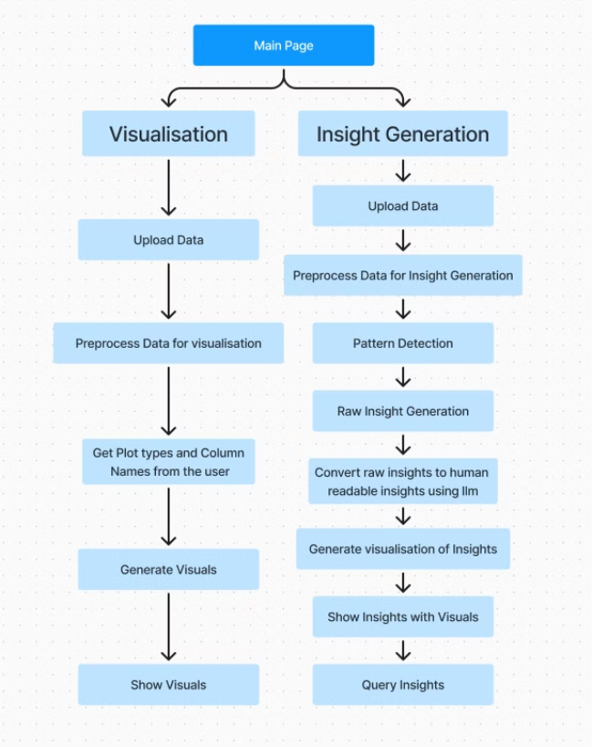
Process Flow

Slide 7
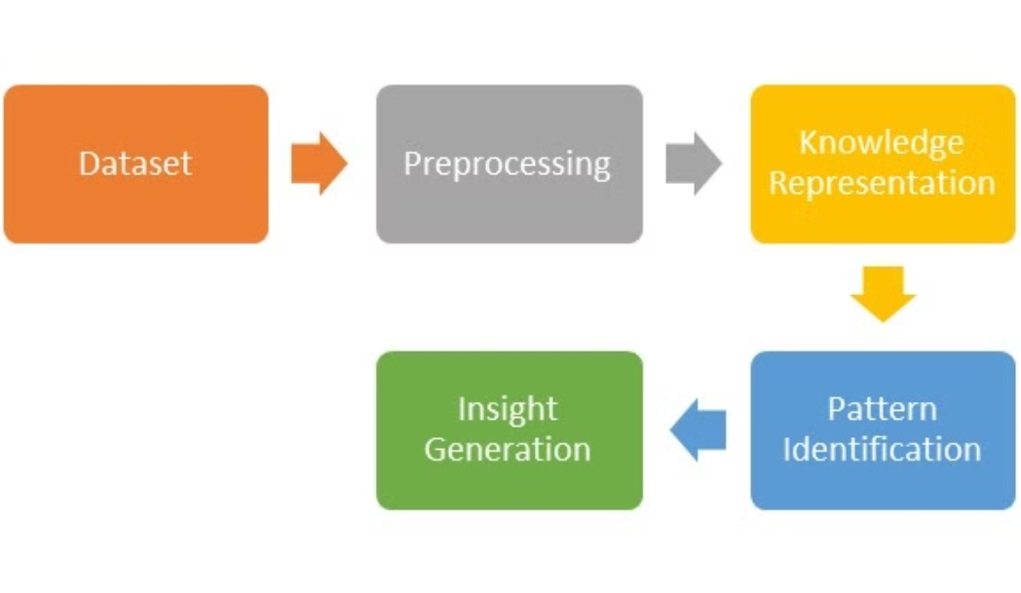
Architecture Diagram

Slide 8
Technologies Used:
Libraries
Platform and Hardware
Processor: 8 core cpu
cudf cuml google-generativeai python-dotenv pandas numpy scipy scikit-learn matplotlib seaborn joblib flask flask-wtf werkzeug python-dateutil
Ram: 16 GB
GPU: NVIDIA RTX 3050 Mobile GPU (4 GB VRAM)
OS: Archlinux

Slide 9
IBRD dataset
The IBRD (International Bank for Reconstruction and Development) dataset provides historical details on the bank's loan activities, including amounts, rates, borrowing countries, and financial data. This comprehensive dataset enables insights into trends in international financial assistance, loan categories, and regional development projects.
Column Information:
Loan Number: (String) Unique identifier for each loan.
Disbursed Amount: (Numeric) Amount of the loan that has been disbursed.
Region: (String) Geographic region of the borrower.
Country Code: (String) ISO code of the borrower country.
Repaid to IBRD: (Numeric) Amount repaid to the IBRD.
Country: (String) Name of the borrower country.
Due to IBRD: (Numeric) Amount still due to the IBRD.
Borrower: (String) Entity receiving the loan.
Exchange Adjustment: (Numeric) Adjustment amount due to exchange rate changes.
Guarantor Country Code: (String) ISO code of the guarantor country.
Guarantor: (String) Name of the guarantor.
Borrower's Obligation: (Numeric) Total obligation of the borrower.
Loan Type: (String) Type of loan provided.
Sold 3rd Party: (Numeric) Amount sold to third parties.
Loan Status: (String) Current status of the loan (e.g., active, closed).
Repaid 3rd Party: (Numeric) Amount repaid to third parties.
Project ID: (String) Identifier for the associated project.
Due 3rd Party: (Numeric) Amount still due to third parties.
Project Name: (String) Name of the associated project.
Loans Held: (Numeric) Total amount of loans held.
Interest Rate: (Numeric) The interest rate applied to the loan.
End of Period: (Date) End date of the loan period.
Original Principal Amount: (Numeric) The initial amount of the loan.
First Repayment Date: (Date) Date of the first repayment.
Cancelled Amount: (Numeric) Amount of the loan that was cancelled.
Last Repayment Date: (Date) Date of the last repayment.
Undisbursed Amount: (Numeric) Amount of the loan that has not been disbursed yet.
Agreement Signing Date: (Date) Date when the loan agreement was signed.

Slide 10
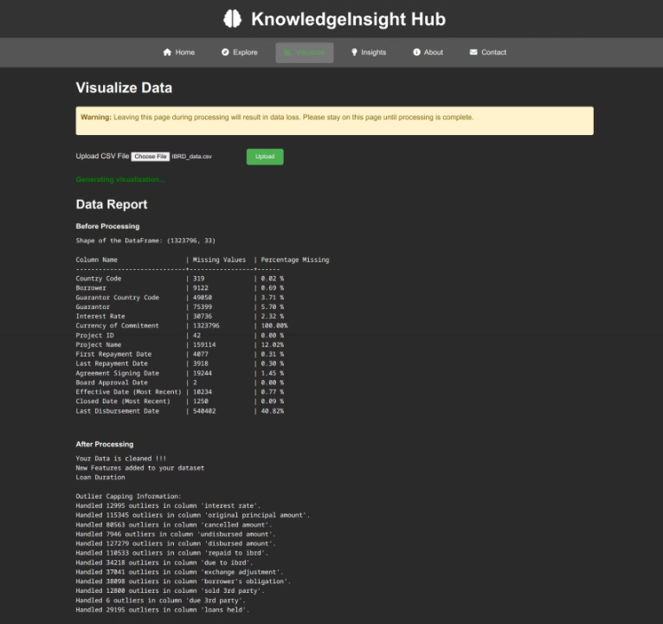
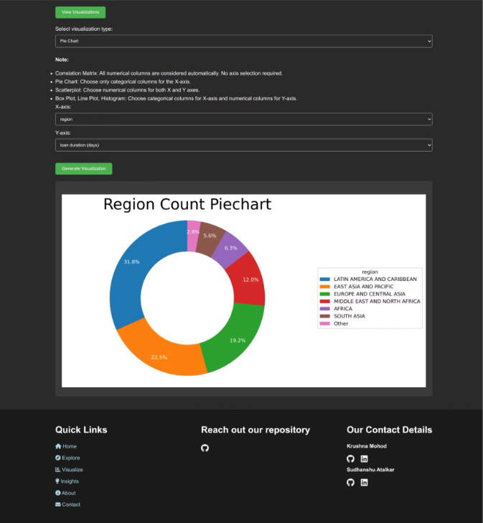
Results:
Data Preprocessing Data Visualisation

Slide 11
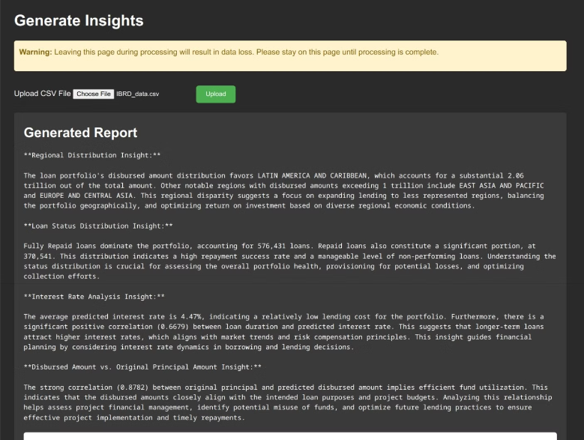
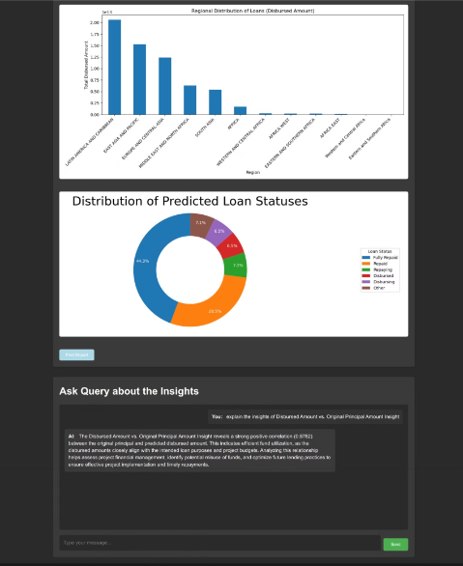
Insight Report Insights Visuals and Query

Slide 12
Team Contribution (Team Name: Quantum Coders)
Krushna Mohod (Team Lead):
Established precise project goals, deliverables, and due dates to keep the team on track.
Developed machine learning models, applying expertise to optimize the efficiency and precision of the algorithms.
Analyzed data to detect patterns, which improved the team's ability to produce insightful findings.
Devised techniques to extract valuable insights from the processed data, facilitating the decision-making process.
Designed an easy-to-use web interface, enhancing the overall user experience.
Created user-friendly UI and UX designs.
Sudhanshu Atalkar(Team Member):
Preprocessed the IBRD dataset for in-depth analysis.
Developed visualizations to highlight key trends and patterns in the data.
Integrated language models to enhance the system's capacity for natural language processing.
Ensured the scalability of the system to handle large datasets.
Leveraged GPU computing to boost the project's processing speed and performance.
Conducted rigorous testing to identify and address any issues or faults.

Slide 13

Thank You

